Slide 1

Student Branch Chapter @ USF
Computer Part Picking
Hardware Lead: Liam

Slide 2

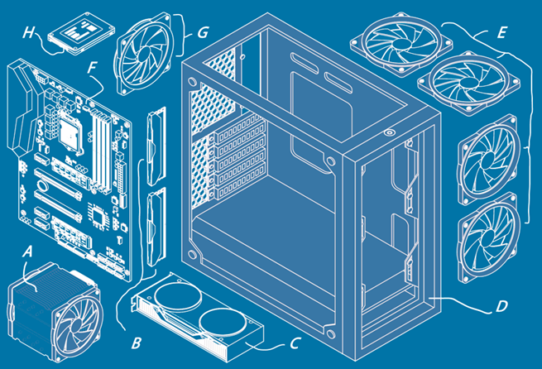
Check in! Support Us

Slide 3
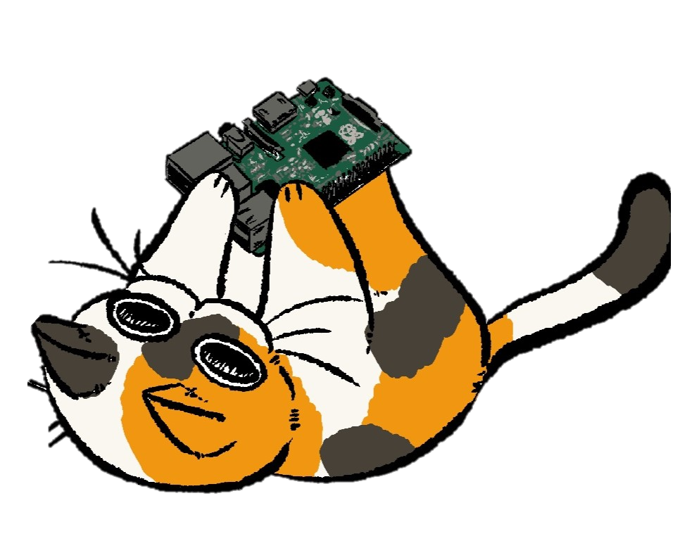

Follow Us
Discord
LinkedIn
Instagram
Bulls Connect
GitHub

Slide 4
What are we doing today?
Cases
Motherboard
CPU
RAM
Storage
GPU
Power
Cooling

Slide 5
Cases

Slide 6
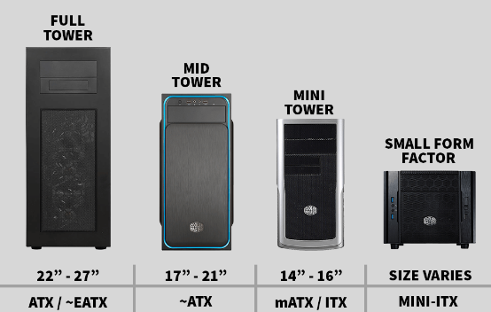
Cases
4 main sizes
EATX
ATX
Micro ATX
Mini ITX
Extension ports for I/O
Controls airflow for PC
CPU clearance (mm)
Fan compatibility

Slide 7
What Case to Choose?
Whatever you want! Just make sure:
CPU clearance exceeds your cooler, or can fit the radiator
Is as big or bigger than the size of your chosen motherboard
I/O has matching sockets to your motherboard connectors if desired
Has good airflow if you need a lot of cooling

Slide 8
Motherboard

Slide 9
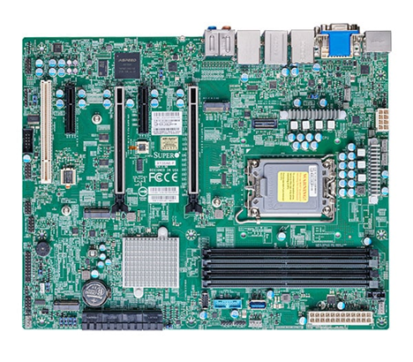
Motherboard Overview
The “Skeleton” of the computer
Every component plugs into it
Has Basic Input Output System (BIOS)
Built in components
Chipset processes I/O and connectivity
CMOS battery saves time and settings
Ports on the back of the PC

Slide 10
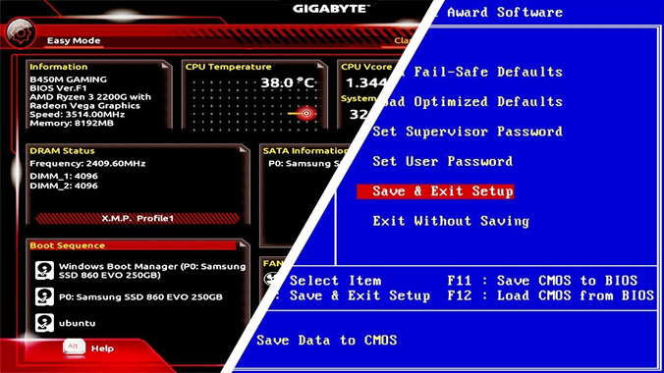
Motherboard BIOS
If you press f12, f2, delete, etc. on startup, you’ll enter BIOS
Every BIOS is unique to motherboard, though are generally similar
BIOS has a mini-system with
settings and time stored by
CMOS battery
Firmware on motherboards may
need to be updated over time

Slide 11
What can you do in BIOS?
See how your computer is performing and what parts are in it
Choose your boot drive / launch settings or boot manually
Change how fast your fans blow to make them quieter or faster
Sometimes you can update BIOS from within itself
Overclock or underclock performance of parts (but can brick them)

Slide 12
What Motherboard Should I Get?
You just have to make sure it’s compatible with everything!
Fits into your computer case
Has to have a matching CPU socket and compatible chipset
Has to fit your chosen RAM type (DDR4 or DDR5)
Has the right ports you want for your PC
Drives
Video
USB
PCIe

Slide 13
CPU

Slide 14
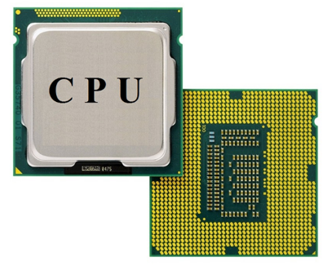
What Does the CPU Do?
The Central Processing Unit performs computations to do most everything for you
Enthusiast desktop processors run the X86 Instruction Set Architecture
Some laptops or experimental PCs run ARM or other ISAs
Has 60+ billion transistors on a single chip now
Circuit cycles billions of time a second to do operations

Slide 15
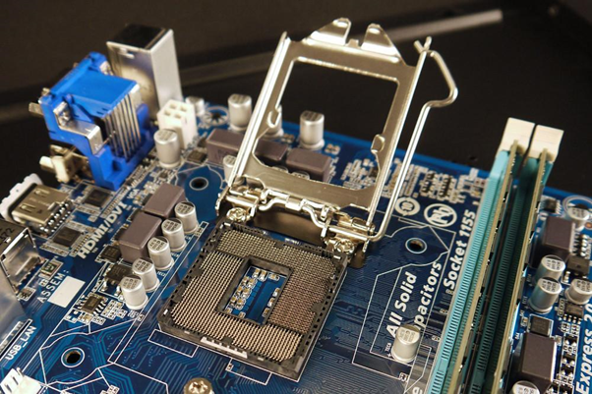
Where Does the CPU Go?
The CPU socket is a large part in the motherboard which opens and holds the CPU
Many fragile pins and contact pads have to fit precisely here or it will not work
Different CPU generations have sockets
Make sure motherboard can fit your CPU

Slide 16
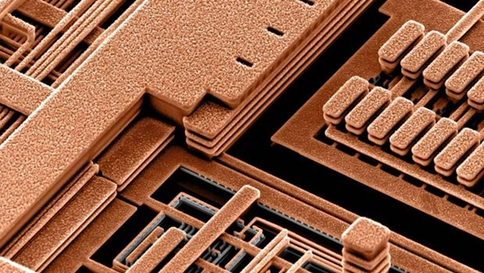
What’s Inside the CPU?
Transistors are made only nanometers apart to fit a massive amount together
Only visible through intense microscopic magnification
Created with very complicated
lithography process where
multiple layers are combined

Slide 17
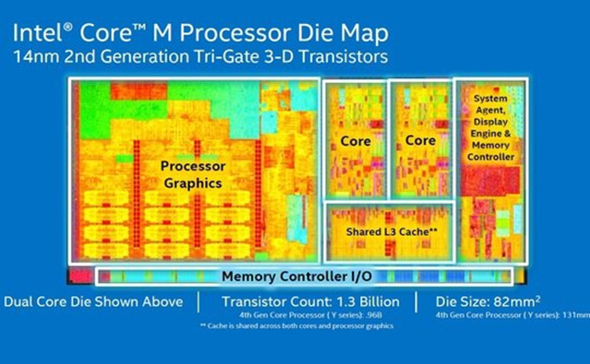
CPU Structure
Each part has its own dedicated function which work together
Cores are the main calculators
Cache is low level fast memory
GPU does graphics processing
Memory controller interfaces
Modern CPUs have many cores

Slide 18
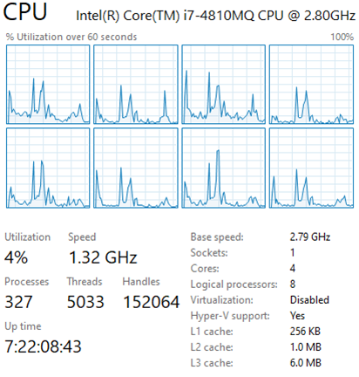
CPU Multithreading
All programs are lists of instructions in order
Computer has hundreds of processes running
Multiple cores allow many processes to run together
If optimized, multiple cores can run programs well
CPUs have started to add many cores to get faster

Slide 19
What CPU is Best?
Buy a latest generation CPU with as much money as the budget allows!
Your CPU is the main determinant of how fast your computer is
You get what you pay for, but old ones are typically overpriced
If you do a lot of multitasking or thread heavy programs, you want more cores
Top end CPUs have diminishing returns and most people don’t need them
Make sure it is compatible with your motherboard

Slide 20
RAM

Slide 21
What is RAM?
Random Access Memory is the main memory of your PC.
It stores all working data and things you’re looking at
Not to be confused with permanent storage, which will come later
Ram is:
Volatile (destroyed when it loses power)
Fast (has to run quickly along the CPU)
Expensive (made of semiconductors like CPU)

Slide 22
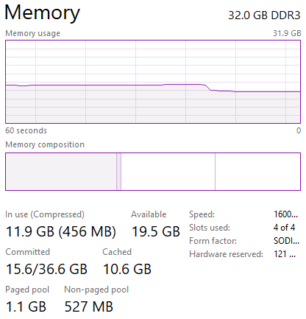
How Does it Help Me?
The more RAM you have, the more things you can have open
When you run out of RAM, everything gets VERY slow
Some tasks like video editing and data processing
require a lot of RAM to manipulate their contents

Slide 23
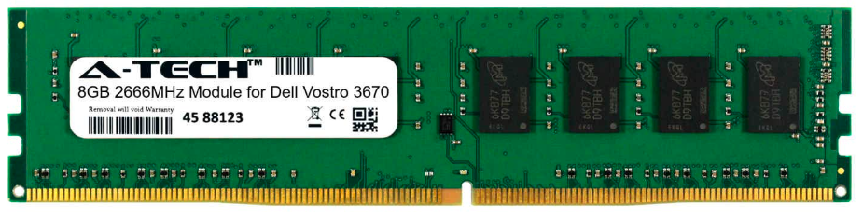
Ok, But What Does RAM Look Like?
RAM comes in small chips attached to a stick shaped circuit
RAM sticks usually have a sticker with their information printed on them
There are several versions of RAM, the newest being DDR5

Slide 24
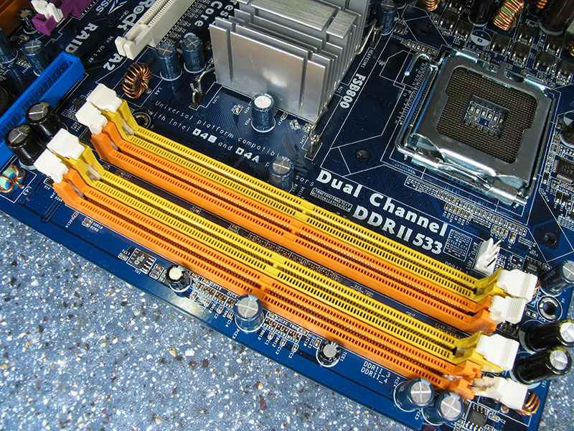
Where Does it Go???
RAM sticks go into the large DIMM slots
located right next to the CPU socket
For timing purposes which enhance PC performance, RAM should be inserted in a specific pattern of matching the colors
This is related to the Double Data Rate (DDR) part of your DDR ram. The two sticks of RAM will operate synchronously

Slide 25
How Much RAM Do I Need?
Most people need 16-32 GB of RAM on a PC nowadays.
Make sure it’s a version compatible with your motherboard
If you have special tasks that need more RAM like video editing, you may want more
RAM will be marketed with an operating frequency, but don’t worry about that much

Slide 26
Storage

Slide 27
Storage Overview
Storage is what saves all our files in our computers
The computer has to read data off our storage every time we load something new, and write it when we save it
There are 2 common types of drives we use to store data
Hard Disc Drive (HDD)
Solid State Drive (SSD)

Slide 28
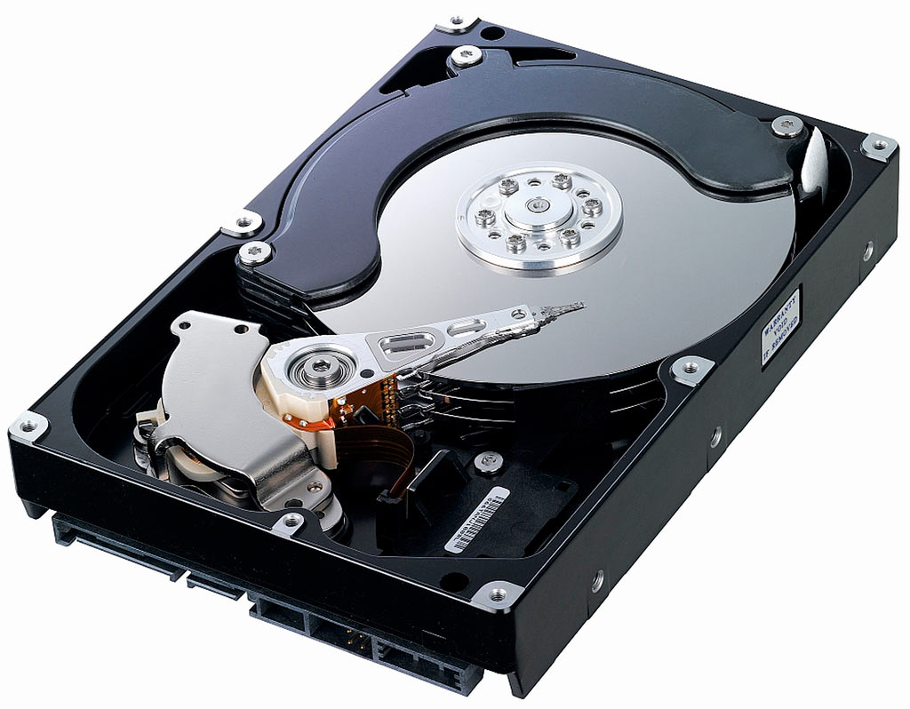
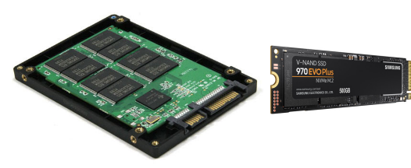
Which Drive Is Best?
Hard Disc Drive
Data stored on Disks like CD
Very large capacity
Cheaper than SSD
Can recover data if it fails
Solid State Drive
Data stored on flash chips
Faster load times
Makes no noise in use
Much smaller and lighter

Slide 29
Storage Recommendation
How much storage you need is very much up to your needs, But:
You probably want at least one SSD to install your operating system on to go fast
Any software or games you want to load fast also should be on an SSD
If you need a lot of storage for things like (totally legal) video or music collections,
make use of HDDs to store a lot of data for relatively cheap

Slide 30
GPU

Slide 31
What’s a GPU Really Do?
A Graphics Processing Unit is a semiconductor chip, like a CPU
Unlike CPU, GPU are significantly limited in scope of purpose
GPUs are designed for one main thing: simple computations
While a CPU has 4-32 compute cores, a GPU could have thousands
Parallelizing all of these cores makes GPUs very fast at what they do
Good at engineering, video rendering for editing and games, and even crypto mining

Slide 32
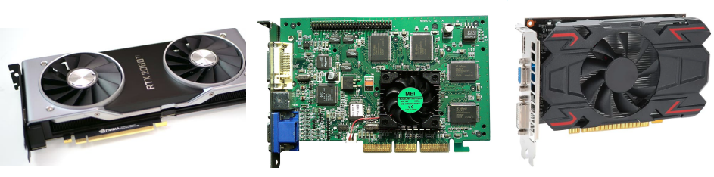
GPU Cards
GPUs are usually found on large graphics card boards which will go into a PCIe slot
GPU cards usually have large and heavy heatsinks to dissipate heat
These cards also contain other chips for handling video compression and encoding, output ports, and other miscellaneous components

Slide 33
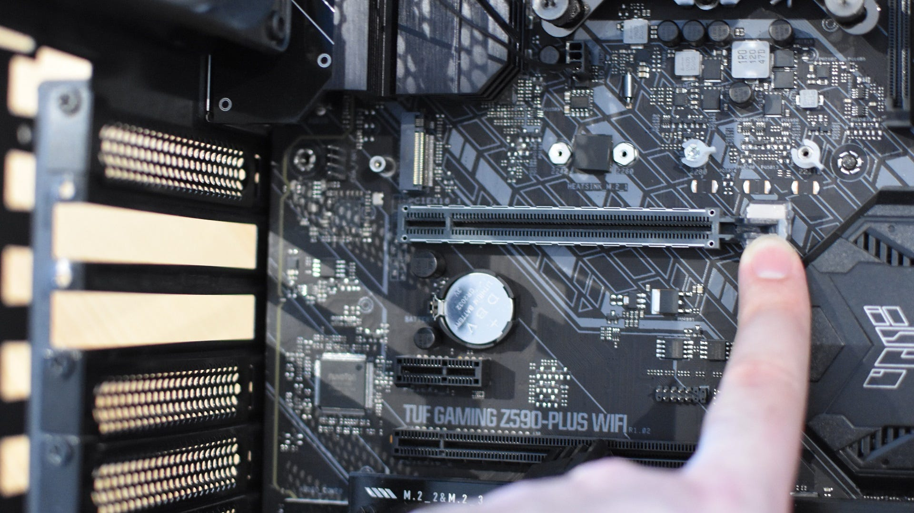
PCIe Slots
Peripheral Component Interconnect express slots general purpose to add devices to a PC
PCIe slots are located in a row on a motherboard, near the back of the pc with cover slots
Examples of other external cards
added on PCIe slots are sound cards,
wireless receivers, extra memory,
or even a second graphics card
Large PCIe slots will have a locking
connector to help hold in large cards

Slide 34
Which GPU Should You Get?
GPUs are very expensive nowadays, but you’ll want one if:
You edit a lot of videos or other large data / image sets or 3D modelling
You want to play big games with intensive graphic features or high FPS
Your CPU doesn’t have integrated graphics (you need at least one)
You want to mine cryptocurrency (in 2024?) and don’t want a dedicated ASIC
The more expensive your GPU is, the better, but prepare to spend a lot for the best

Slide 35
Power

Slide 36
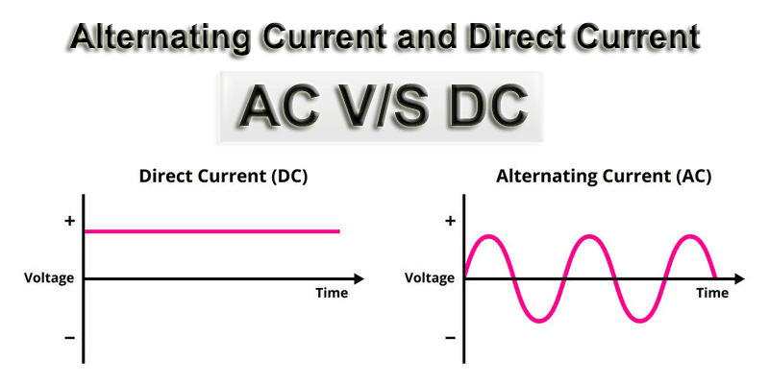
Current

Slide 37
AC/DC
Your PC needs a Power Supply Unit to power it, just like a phone charger
Converts AC from an electricity outlet into DC for a computer to use
Often times as much as >1000W power output for a PC nowadays
PCs demand high quality and stable DC power to run properly and not crash

Slide 38
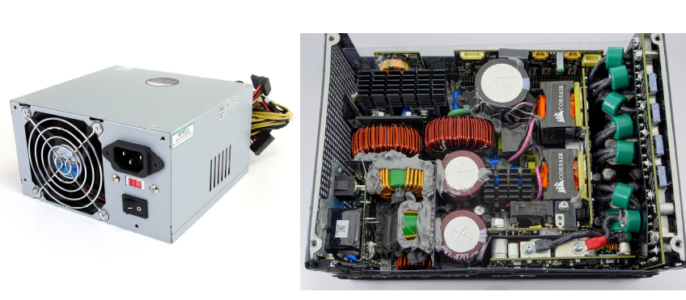
Don’t Open a PSU; You Could Die

Slide 39
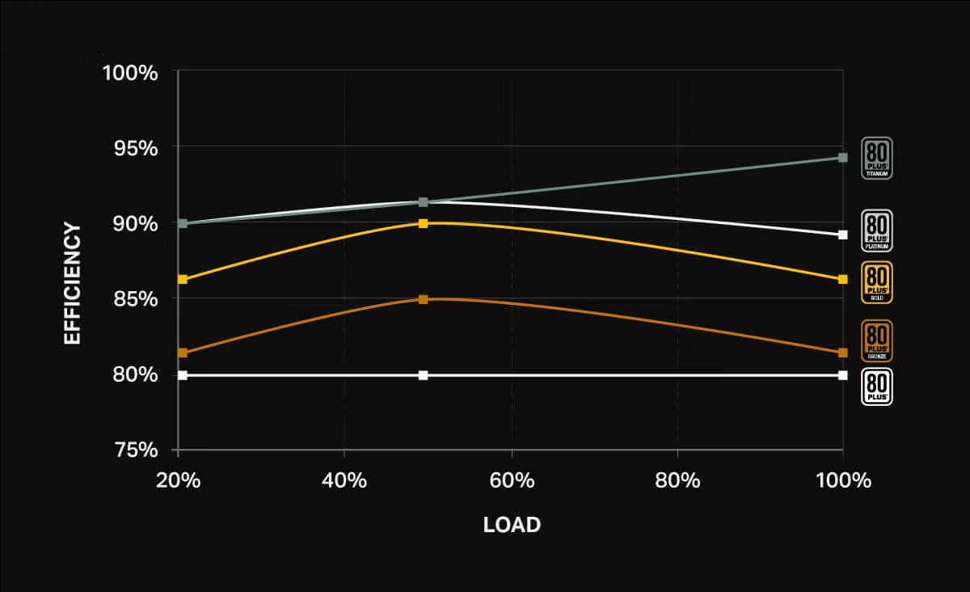
80+ Performance Enhancements

Slide 40
How Big Does My PSU Have to Be?
Bigger is better, but not too big
Your CPU and GPU power consumption in wattage must be covered
Find the wattage of your CPU and GPU, add together and double it
Try for an 80+ gold or better if you need to save electricity
Some power supplies will have quiet eco modes if you care about noise

Slide 41
Cooling

Slide 42
Staying Cool
Computers are toasters with extra steps
Every watt of energy (almost) you put into your computer will turn into heat at some point, which you need to get rid of
Too much heat in parts will slow them down and degrade them faster, or kill them
Heatsinks and case airflow is how we achieve cooling

Slide 43
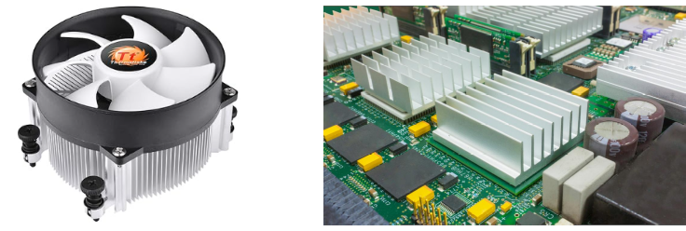
CPU Cooler
Your CPU will need a cooler of its own, if it doesn’t come with one
Many smaller parts also have simple heatsinks to radiate heat into the area
Cases need fans attached and plugged into the motherboard to circulate hot air

Slide 44
What Cooling Do I Need?
A few fans is all that’s typically necessary, but:
CPUs can come with their own, so check if you even need one for it
If you need to get a cooler, make sure it’s rated for your CPU wattage and case clearance
GPUs usually come with their own cooler on the card

Slide 45
Conclusion

Slide 46


Next workshops ☺ !

Slide 47
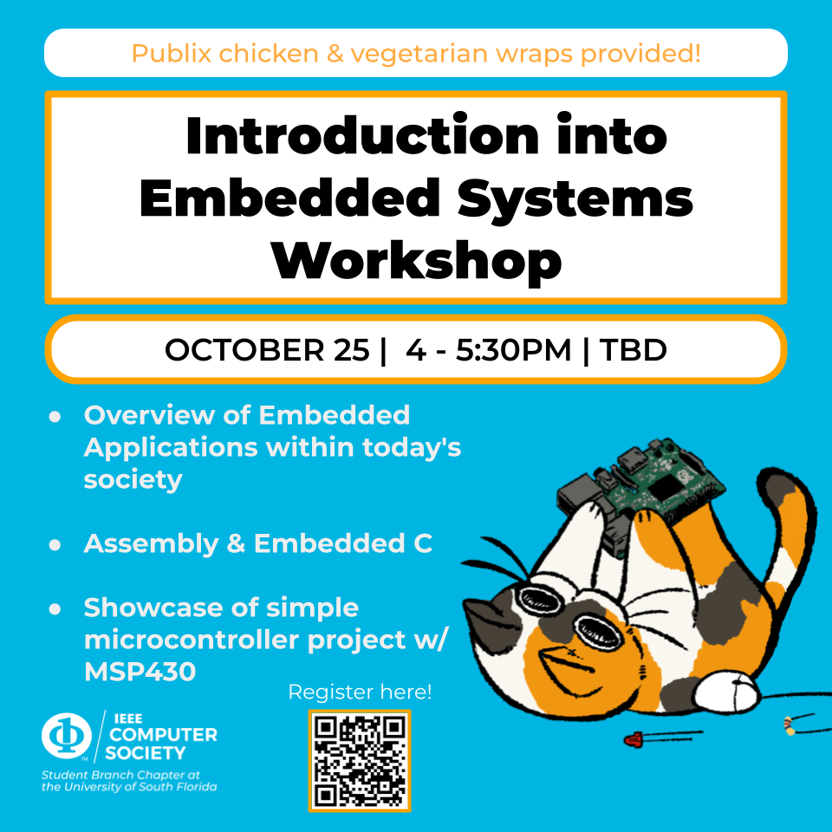

Next workshops ☺ !

Slide 48
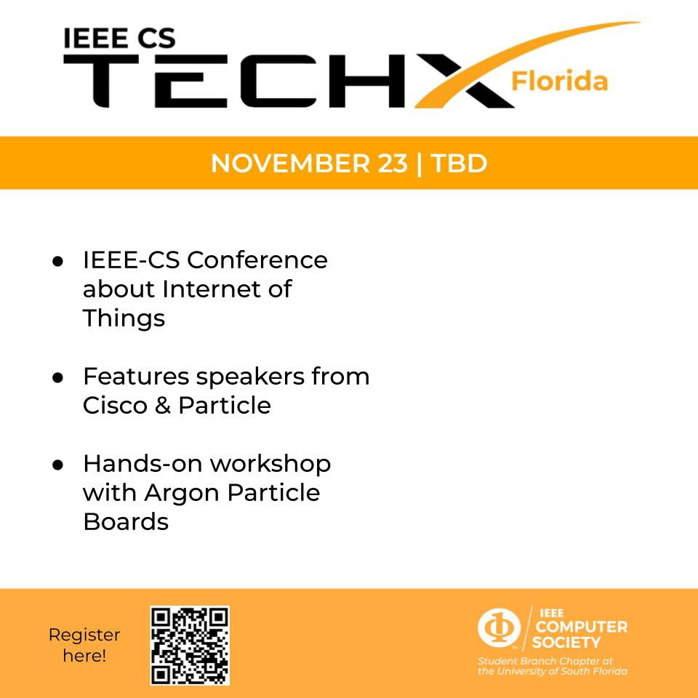
Next workshops ☺ !

